Slide 1
FP Deal flow in Right Price 2.0 Application
20th February,2019

Slide 2
Table of Contents
The following are the user categories defined in Right Price 2.0 application based on the workflow from initiation of FP deals to approval by DD, BU Head, COO and/or CEO based on margin threshold.
Delivery
Delivery Director
Quality Team’s Approval (In case of Development deals)
GFT
4) BUH
5) COO
6) CEO

Slide 3
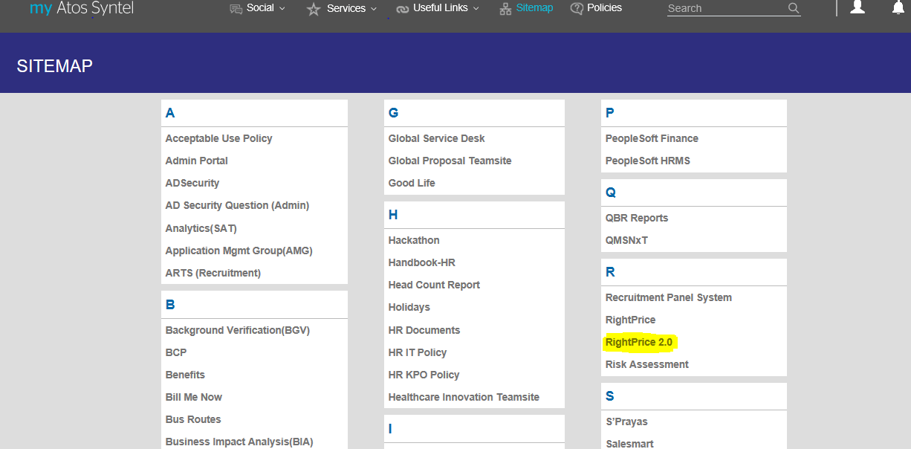
Delivery Log In
Right Price (RP) 2.0 is available on My Atos-Syntel platform. Below is the screen of RP 2.0 menu under Sitemap highlighted & is common screen in all users login.

Slide 4
Selection of Deal
Delivery person from an Account shall be allowed to create Fixed Price Deals in the Right Price System. The module shall allow user to add/view/update details for Fixed Prices Deals depending on the access of the logged in user. Below 2 types of deals shall be available in case of Fixed Price:
Automatic
Manual
User can navigate to the Fixed Price Deals via Right Price Portal -> Deal -> Fixed Price or by clicking on the Deals hyperlink in the Dashboard screen. The Navigational panel shall appear at the extreme right side of the screen, which can be used to navigate to any screen for the selected deal.
Depending upon the option selected on the “FP Deal Creation – Deal Details” screen, Automatic or Manual Fixed Price Deals shall be created. If Manual Deal option selected is No, Automatic Deals shall be created. If “Yes” is selected in the Manual Deal option, Manual Fixed Price Deals shall be created.

Slide 5
Fixed Price (FP) Deals – Automatic Deals
Below are the sequential set of screens that shall appear in case of Automatic FP Deals:
FP Deal Creation – Deal Details
Tower Details
Role Selection
Staffing
Cost Inputs (Travel/Relocation/SGA)
Upload Estimation Related Documents
What if Analysis
Cost Summary
Finalize Deal

Slide 6
Screen 1: FP Deal Creation Details

Slide 7
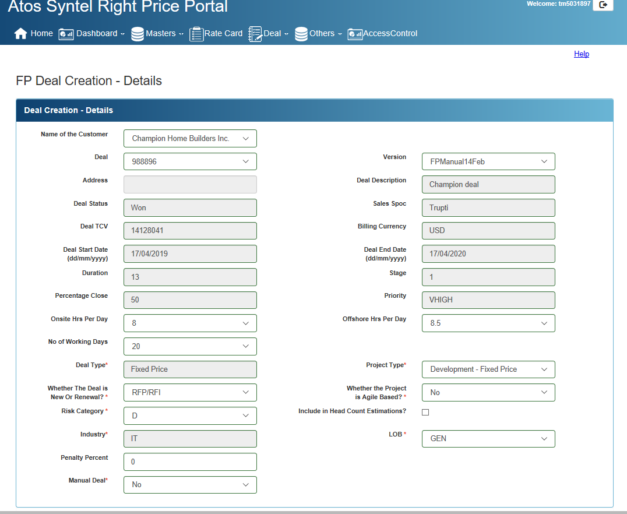
FP Deal Creation – Details’ Screen (1/3)
After selecting the deal in the previous screen the below screen appears. The fields marked in *(star)requires selection from user for the purpose of Deal Costing.

Slide 8
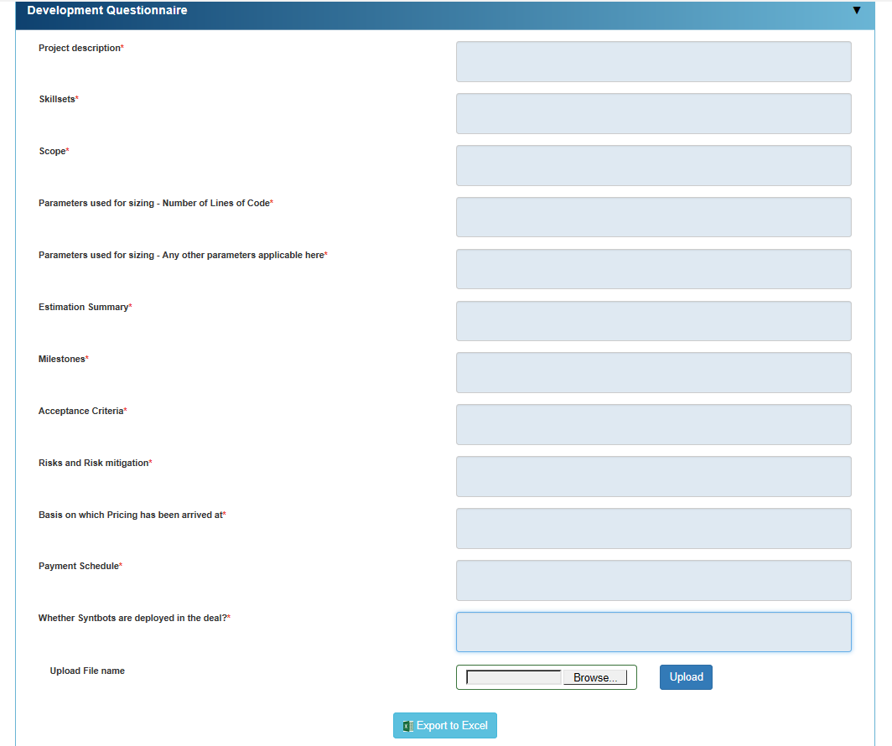
FP Deal Creation – Details’ Screen (2/3)
In RP 2.0 the details which are generally asked from GFT relating to the deals can be provided in the system itself that would help to reduce the TAT. Below is the screenshot of the same for reference:

Slide 9
FP Deal Creation – Details’ Screen (3/3)
Multiple versions of a deal can be created for that an user has to select Copy As New Version. New versions can only be created for deals which are in Draft Status. In case of Copy as New Version, data until Staffing screen shall be copied. The screen shall open in Read Only mode for all other users having valid access other than Delivery.

Slide 10
Screen 2:Tower Details

Slide 11
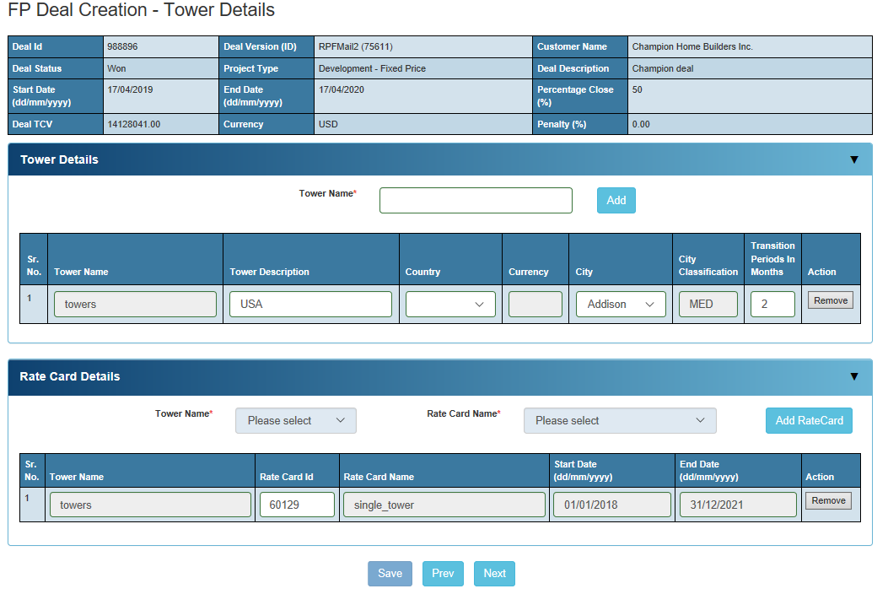
FP Deal Creation – Tower Details’ Screen
This screen allows an user to enter Tower Details corresponding to each country and each city. It allows to select Rate Card for each tower that is created. Rate Cards shall be populated depending on the Customer, Tower Country, Tower City Category, Start Date and End Date of the Deal.

Slide 12
Screen 3:Role Selection

Slide 13
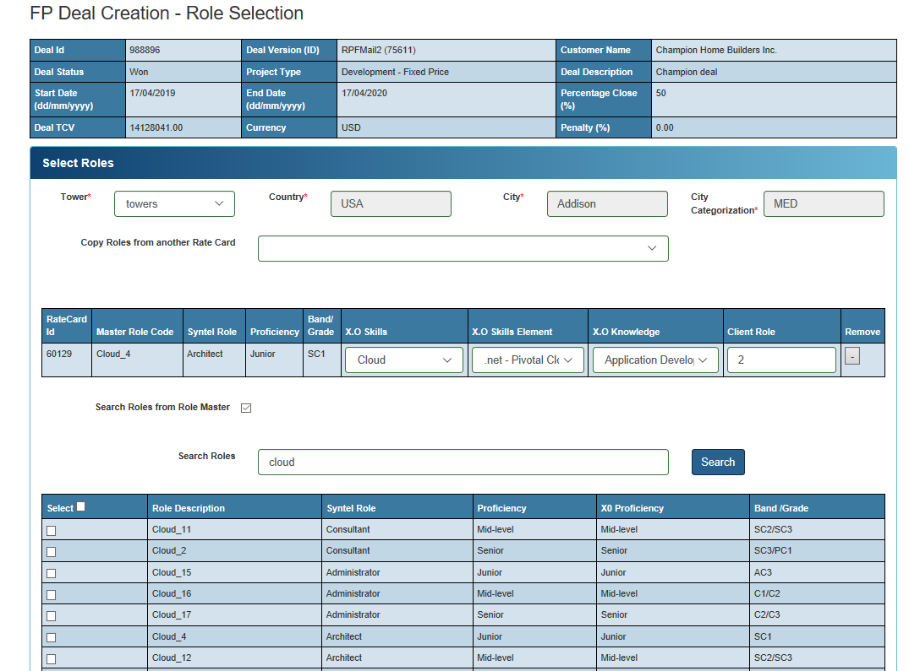
FP Deal Creation – Role Selection
This screen allows an User to select Roles for the Towers that were created. Roles can be selected from the Rate Cards or by entering the key word in the Search Roles textbox.

Slide 14
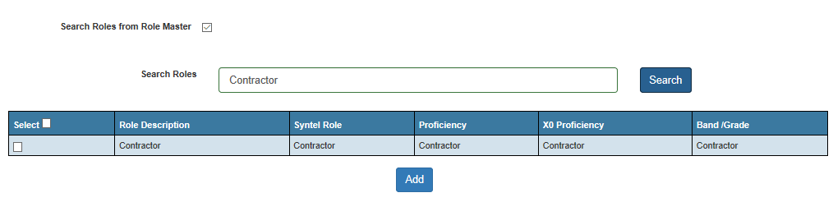
In case of Managed Services or Managed Capacity project an user shall select the Rate Card roles only
For contractor roles the user shall enter the key word ‘Contractor’ in search roles textbox.

Slide 15
Screen 4: Staffing/Efforts

Slide 16
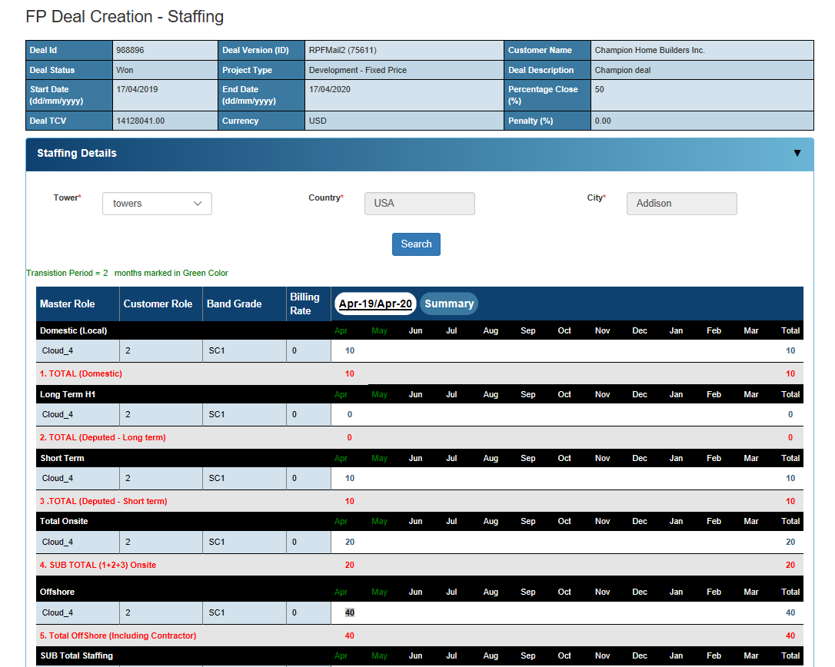
FP Deal Creation – Staffing/Efforts
This screen will allow user to enter Staffing details against a Tower. The staffing details can be entered manually via the Staffing Details section or by uploading the Staffing excel in “Upload Deal Staffing Excel” section.

Slide 17
Screen 5: Cost Inputs (Travel,Relocation,SGA,Shift Charges)

Slide 18
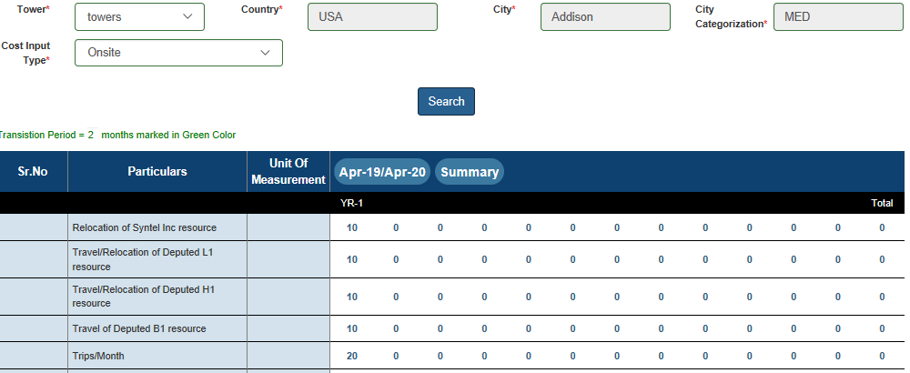
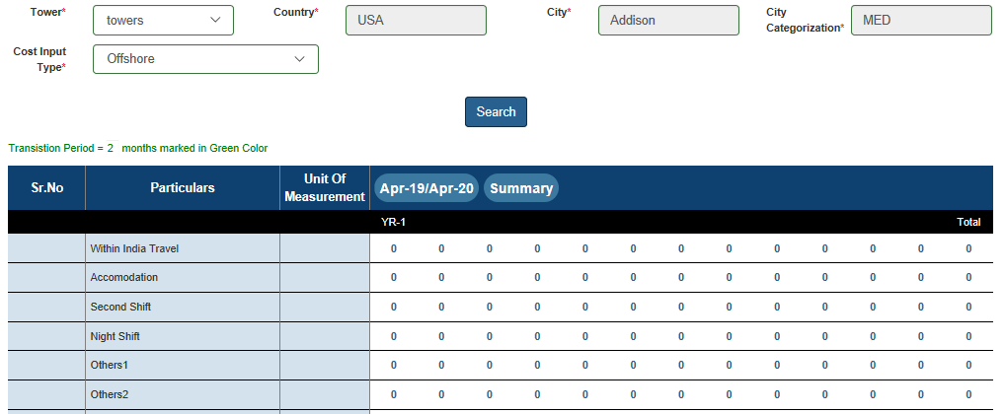
FP Deal Creation – Cost Inputs
This screen allows an user to enter travel, relocation cost, project specific cost, shift charges for Onsite, Offshore. These details are entered against each Tower

Slide 19
Screen 6: Upload Estimation Related Documents

Slide 20
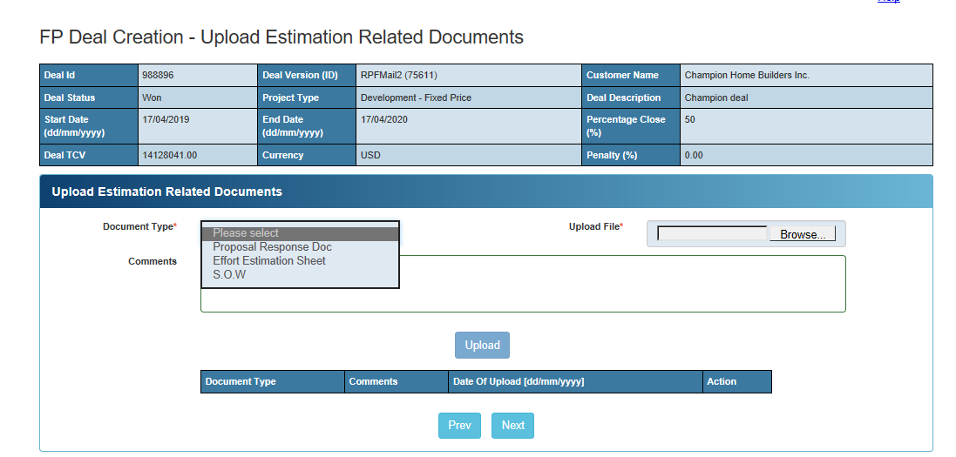
FP Deal Creation – Upload Documents
This screen shall be visible only for deals whose Project Type is “Development”. This screen will allow an user to upload Proposal Estimation Document, Effort Estimation Sheet, and SOW

Slide 21
Screen 7: What If Analysis

Slide 22
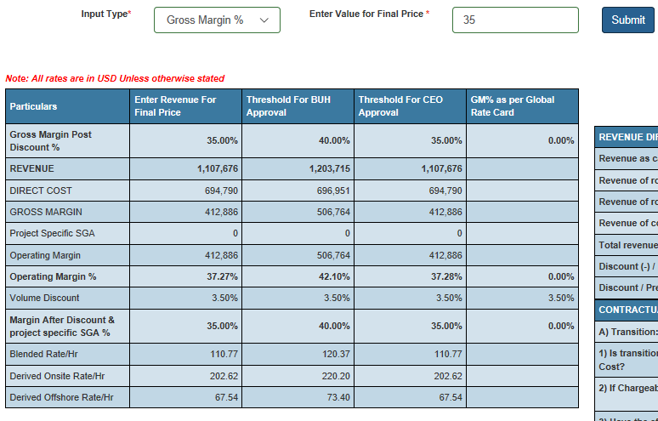
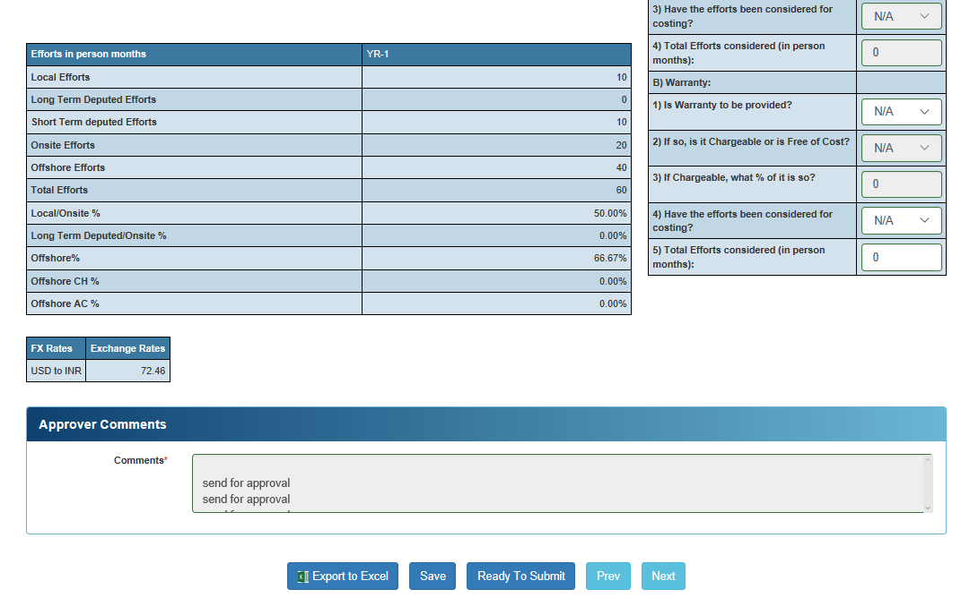
FP Deal Creation – What If Analysis
This screen displays the Summary of the Deal. This will allow an user to compute the Margin % as per the Input Type (Gross Margin % or Revenue) selected and the value entered in the corresponding “Enter Value for Final Price” field. User shall be allowed to proceed beyond What If Analysis, only if Staffing details are entered for all the years of the Deals. If a version needs to be Sent for Approval, Ready to Submit needs to be clicked.

Slide 23
Screen 8: Cost Summary

Slide 24
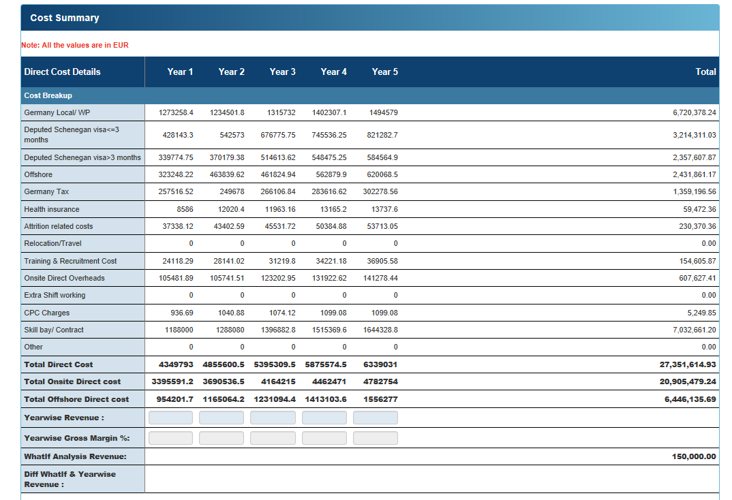
FP Deal Creation – Cost Summary
This screen displays the Year Wise Cost breakup for a Deal.

Slide 25
Screen 9: Finalize Deal

Slide 26
FP Deal Creation – Finalize Deal
This screen displays the sequential flow of the approver matrix. If the Deal is New/Renewal, then only one version can be selected and be sent for approval. Once the version is sent for approval, the remaining versions shall be deactivated and will not be available in the system to view. (Fig: FP Deal Creation – Finalize Deal (New/Renewal)
In case of “RFP/RFI”, multiple versions can be selected and be sent for approval. Once the versions are selected and sent for approval, the remaining versions shall be deactivated and will not be available in the system to view. Out of the selected versions that are sent for approval, once all are approved on the Finalize Deal screen only one version can be selected for final approval. This version shall be considered as Finalized version for the Deal. (Fig: FP Deal Creation – Finalize Deal (RFP/RFI))

